Slide 1

FPT University
Android programMing
Lesson 12
Version 1.0

Slide 2
Agenda
Android Services
Started Services
Local Bound Services
Remote Bound Services

Slide 3
Android Services
Overview of Android Started and Bound Services
The Android Service class is designed specifically to allow applications to initiate and perform background tasks
Unlike broadcast receivers, which are intended to perform a task quickly and then exit, services are designed to perform tasks that take a long time to complete

Slide 4
Android Services
Started services are launched by other application components and potentially run indefinitely in the background until the service is stopped or is destroyed by the Android runtime system in order to free up resources

Slide 5
Android Services
Intent Service is a specialized subclass of the Service class that simplifies service creation and usage. An IntentService is meant to handle individual autonomous calls. Unlike a service, which can concurrently handle multiple calls, an IntentService is more like a work queue processor

Slide 6
Android Services
Bound service is a service that has some other component (typically an Activity) bound to it. A bound service provides an interface that allows the bound component and the service to interact with each other. Once there are no more clients bound to the service, Android will shut the service down.

Slide 7
Android Services
The Anatomy of a Service A service must, as has already been mentioned, be created as a subclass of the Android Service class or IntentService, and must implement some of override methods:
onStartCommand()
onBind()
onCreate()
onDestroy()
onHandleIntent()
Notes:
onStartCommand() – This is the method that is called when the service is started by another component via a call to the startService() method. This method does not need to be implemented WOW! eBook www.wowebook.org for bound services. · onBind() – Called when a component binds to the service via a call to the bindService() method. When implementing a bound service, this method must return an IBinder object facilitating communication with the client. In the case of started services, this method must be implemented to return a NULL value. · onCreate() – Intended as a location to perform initialization tasks, this method is called immediately before the call to either onStartCommand() or the first call to the onBind() method. · onDestroy() – Called when the service is being destroyed. · onHandleIntent() – Applies only to IntentService subclasses. This method is called to handle the processing for the service. It is executed in a separate thread from the main application

Slide 8
Android Services
Controlling Destroyed Service Restart Options
START_NOT_STICKY
START_STICKY
START_REDELIVER_INTENT

Slide 9
Android Services
Starting a Service Running on System Startup Given the background nature of services, it is not uncommon for a service to need to be started when an Android based system first boots up. This can be achieved by creating a broadcast receiver with an intent filter configured to listen for the system android.intent.action.BOOT_COMPLETED intent. Note that, in order to function, such a broadcast receiver will need to request the android.permission.RECEIVE_BOOT_COMPLETED permission.

Slide 10
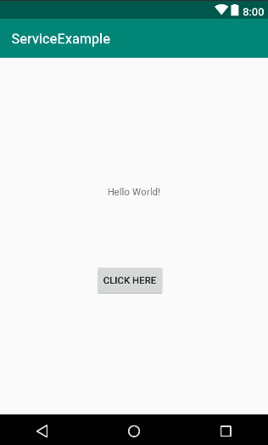
Implementing an Android Started Service
Creating the Example Project

Slide 11
Implementing an Android Started Service
Using IntenｔService for a simple demo
@Override protected void onHandleIntent(Intent intent) { Toast.makeText(getApplicationContext(),
"Intent Service started",Toast.LENGTH_SHORT).show(); }

Slide 12
Implementing an Android Started Service
Starting Intent service
public class ServiceExampleActivity extends AppCompatActivity { @Override protected void onCreate(Bundle savedInstanceState) { super.onCreate(savedInstanceState); setContentView(R.layout.activity_service_example); Intent intent = new Intent(this, MyIntentService.class); startService(intent); } }

Slide 13
Implementing an Android Started Service
Creating the New Service for Started Service
public int onStartCommand(Intent intent, int flags, int startId) { Log.i("ServiceLog","Service started"); synchronized (this){ try { for (int i = 0; i < 3; i++) { wait(1000); } } catch (InterruptedException e) { e.printStackTrace(); } Log.i("ServiceLog", "Service is running"); } stopSelf(); return Service.START_STICKY; }

Slide 14
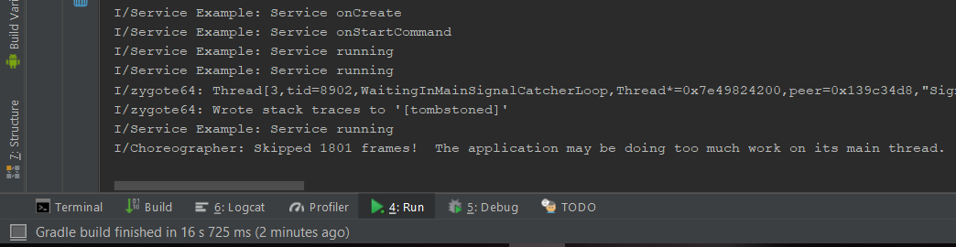
Implementing an Android Started Service
Issue working too much on main thread make the application not responding. So that we need to create new thread for service task.

Slide 15
Implementing an Android Started Service
Creating a New Thread for Service Tasks
@Override public int onStartCommand(Intent intent, int flags, int startId) { final int currentId = startId; Runnable r = new Runnable() { public void run() { for (int i = 0; i < 1000; i++) { long endTime = System.currentTimeMillis() + 10*1000; while (System.currentTimeMillis() < endTime) { synchronized (this) { try { wait(endTime - System.currentTimeMillis()); } catch (Exception e) { } } } Log.i(TAG, "Service running " + i + ": currentID = " + currentId); } stopSelf(); } }; Thread t = new Thread(r); t.start(); return Service.START_STICKY; }

Slide 16
Android Bound Services Understanding
Understanding Bound Services
Bound services are created as sub-classes of the Android Service class and must, at a minimum, implement the onBind() method
Clients wishing to bind to a service must also implement a ServiceConnection subclass containing onServiceConnected() and onServiceDisconnected() methods

Slide 17
Android Bound Services Understanding
Bound Service Interaction Options There are two recommended mechanisms for implementing interaction between client components and a bound service
In the event that the bound service is local and private, the recommended method is to create a subclass of the Binder class and extend it to provide an interface to the service
In situations where the bound service is not local to the application, interaction is best achieved using a Messenger/Handler implementation.

Slide 18
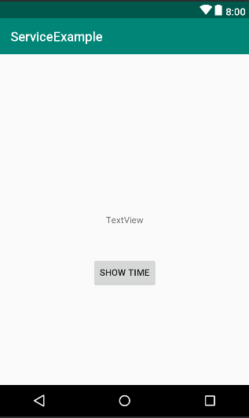
Local Bound Service Example
Create Bound Service Example Project
We will get the system time and display on the textView when button is clicked

Slide 19
Local Bound Service Example
Adding a Bound Service to the Project and implement IBinder
public class LocalBoundService extends Service { public LocalBoundService() { } private final IBinder myBinder = new MyLocalBinder(); @Override public IBinder onBind(Intent intent) { return myBinder; } public String getCurrentTime() { return new Date().toString(); } public class MyLocalBinder extends Binder { LocalBoundService getService() {return LocalBoundService.this;} } }

Slide 20
Local Bound Service Example
Binding the Client to the Service
public class LocalBoundActivity extends AppCompatActivity { LocalBoundService myService; boolean isBound = false; @Override protected void onCreate(Bundle savedInstanceState) { super.onCreate(savedInstanceState); setContentView(R.layout.activity_local_bound); Intent intent = new Intent(this, LocalBoundService.class); bindService(intent, myConnection, Context.BIND_AUTO_CREATE); } }

Slide 21
Local Bound Service Example
Implement connection
private ServiceConnection myConnection = new ServiceConnection() { @Override public void onServiceConnected(ComponentName name, IBinder service) { myService =((LocalBoundService.MyLocalBinder)service).getService(); } @Override public void onServiceDisconnected(ComponentName name) {
} };
public void showTime(View view) { String currentTime = myService.getCurrentTime(); TextView myTextView = (TextView)findViewById(R.id.textView); myTextView.setText(currentTime); }

Slide 22
Local Bound Service Example
Testing application

Slide 23
Remote Bound Services
Client to Remote Bound Service Communication
Remote bound service is running in a different process and cannot be reached directly from the client.
In the case of remote bound services, a Messenger and Handler configuration must be created which allows messages to be passed across process boundaries between client and service

Slide 24
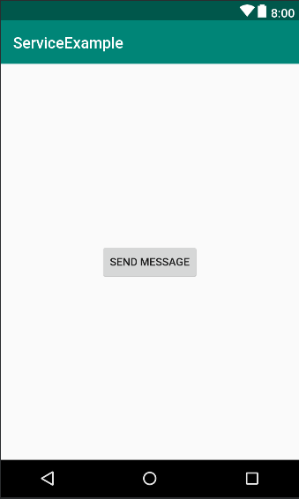
Remote Bound Services
Creating the Remote Bound Services Example

Slide 25
Remote Bound Services
Implement the Remote Bound Service Handler
final Messenger myMessenger = new Messenger(new IncomingHandler()); @Override public IBinder onBind(Intent intent) { return myMessenger.getBinder(); } class IncomingHandler extends Handler { @Override public void handleMessage(Message msg) { Bundle data = msg.getData(); String dataString = data.getString("MyString"); Toast.makeText(getApplicationContext(), dataString, Toast.LENGTH_SHORT).show(); } }

Slide 26
Remote Bound Services
Binding to the Remote Service
Messenger myService = null; boolean isBound; @Override protected void onCreate(Bundle savedInstanceState) { super.onCreate(savedInstanceState); setContentView(R.layout.activity_remote_bound_service); Intent intent = new Intent(getApplicationContext(), RemoteBoundService.class); bindService(intent, myConnection, Context.BIND_AUTO_CREATE); } private ServiceConnection myConnection = new ServiceConnection() { public void onServiceConnected(ComponentName className, IBinder service) { myService = new Messenger(service); isBound = true; } public void onServiceDisconnected(ComponentName className) { myService = null; isBound = false; } };

Slide 27
Remote Bound Services
Sending a Message to the Remote Service
public void sendMessage(View view) { if (!isBound) return; Message msg = Message.obtain(); Bundle bundle = new Bundle(); bundle.putString("MyString", "Message Received"); msg.setData(bundle); try { myService.send(msg); } catch (RemoteException e) { e.printStackTrace(); } }

Slide 28
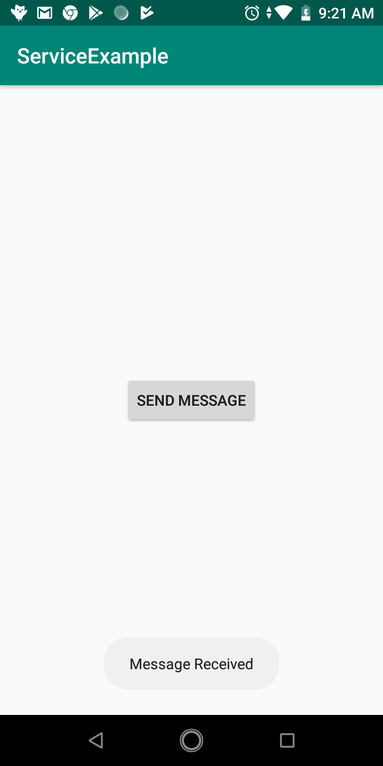
Remote Bound Services
Testing application

Slide 29

End of Lesson 12

Slide 30
Thank you!

